Slide 1
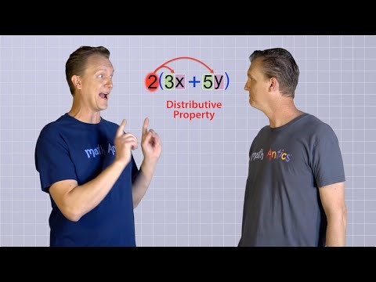
24
7
30
Algebra
Date
EQ – Describe how we use the distributive law to expand brackets
What is the distributive law?
he Distributive Law says that multiplying a number by a group of numbers added together is the same as doing each multiplication separately.
Example: 3 × (2 + 4) = 3×2 + 3×4
Notes:
WATCH THE SECOND HALF of the video

Slide 2




24
7
30
Algebra
Date
EQ – Describe how we use the distributive law to expand brackets
How do I expand brackets
Using the grid method??
Examples:
$3a \left(b+10\right)$ =
 | $$b$$ | $$10$$
$$3a$$
$$3a × b$$
$$3a ×10$$

Slide 3




24
7
30
Algebra
Date
EQ – Describe how we use the distributive law to expand brackets
How do I expand brackets
Using the grid method??
Examples:
$10x \left(3−x\right)$ =
 | $$3$$ | $$−x$$
$$10x$$
$$10x ×3$$
$$10x × −x$$

Slide 4





24
7
30
Algebra
Date
EQ – Describe how we use the distributive law to expand brackets
How do I expand brackets
Using the grid method??
Examples:
$6a \left(a+2a+b\right)=$
 | $$a$$ | $$2a$$ | $$b$$
$$6a$$
$$6a×a$$
$$6a×2a$$
$$6a×b$$

Slide 5
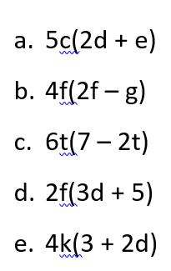
Now it’s your Turn

